Slide 1
Distance Sampling in unmarked
Evan Adams and Beth Ross
8/6/2021

Slide 2
Learning Objectives
Understand what distance sampling is and how it is similar/different to the other hierarchical models we’ve described today
Use a distance sampling model to estimate population size of animals in a point count survey
Evaluate the goodness-of-fit for distance models
Incorporate environmental covariates into distance sampling models to test hypotheses with the data

Slide 3
What is distance sampling?
Estimating density/abundance
Using distance to the observation to estimate detection probability within the survey area
We only need to visit the site once to get this information!
Similar hierarchical structure to N-mixture models, it’s just the detection model that is different

Slide 4
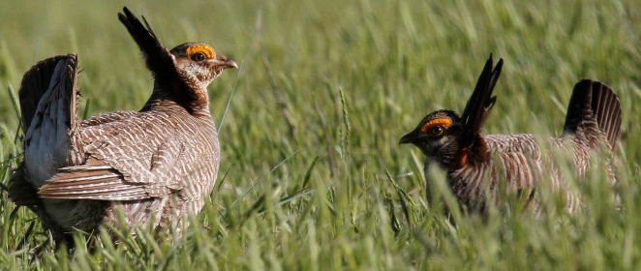




Distance sampling model structure
$$N_{i}\sim Poisson\left(λ_{i}\right)$$
$$y_{i} \sim Binomial\left(N_{i},p_{i}\right)$$
Observations (site i)
$\log\left(λ_{i}\right)=β_{0}+β_{1}X_{i}+ε$
$$p_{i} = ????$$

Slide 5
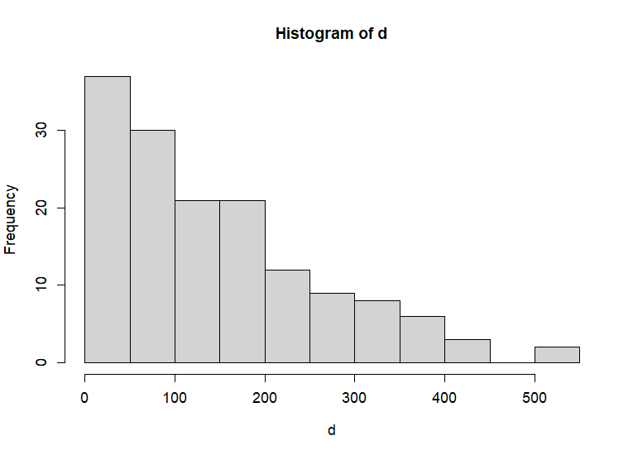
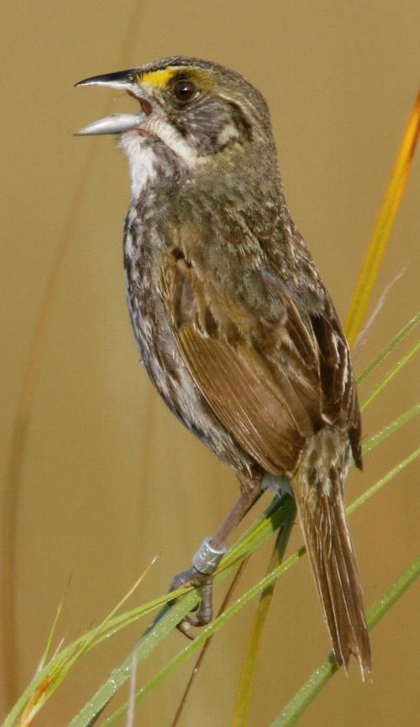
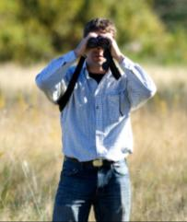
Detectability
d

Slide 6
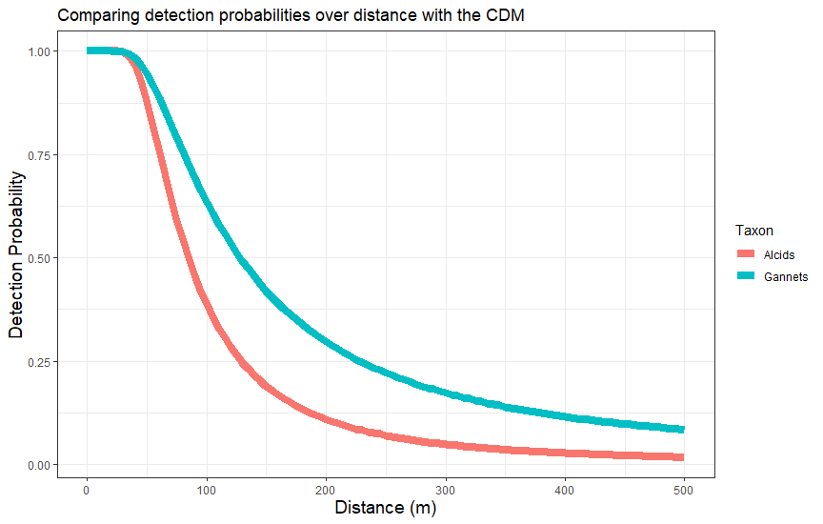
Detectability
Detection probability decreases with distance at different rates for each of the species. Here we assume that detection probability is 100% when the observation is <1 m away.
Detection Functions:
Exponential
Half-normal
Hazard Rate
Uniform (no change in detectability)
Species with higher average distances to the observer are detected at a higher rate throughout the survey area.

Slide 7


Detection Model
Half-normal:
Sigma can be modulated with covariates:
$$g(y){=exp⁡\left(−\frac{y^{2}}{2σ_{i}^{2}}\right)}$$
$$\log\left(σ_{i}\right)= β_{0}+β_{1,i} …+β_{n,i}$$
i= sites
n=covariates
y=midpoint of distance bin
Notes:
Add the covariates here:
Sigmai <- wind + temp
Sigma(ijk) in the top

Slide 8

Detection Model
Hazard:
Note the two parameters that alter shape (σ) and scale (θ)
Sigma can be modulated with covariates:
$$\operatorname{cloglog}\left(g(y)\right)= θ\log\left(σ_{i}\right)−θlog⁡(y_{k})$$
$$\log\left(σ_{i}\right)= β_{0}+β_{1,i} …+β_{n,i}$$
i= sites
n=covariates
y=midpoint of distance bin
Notes:
Add the covariates here:
Sigmai <- wind + temp
Sigma(ijk) in the top

Slide 9
Assumptions
Animals are distributed randomly in the survey area
You report the distance to the animal upon first detection
Observations are independent
Population closure
No false positives or double counts

Slide 10
Single Season Distance Sampling
Data: y_{i} (counts at site i)
d_{k}(distance of observation k)
Observation process/model:
y_{i}|N_{i} ~ Binomial(N_{i}, p_{i})
State process:
N_{i} ~ Poisson(λ_{i})

Slide 11
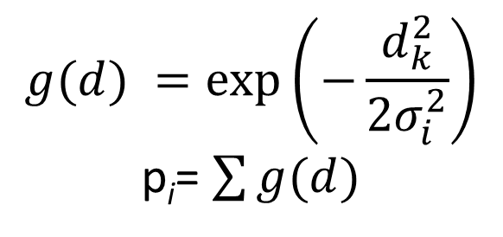
Detection probability: p
Probability of detecting an individual is described with a detection function
Half-normal function: y_{i}|N_{i} ~ Binomial(N_{i}, p_{i})
Distance observations allow us to estimate detection probability
Data are continuous but often binned and truncated to
$$g(d){=exp⁡\left(−\frac{d_{k}^{2}}{2σ_{i}^{2}}\right)}$$
p_{i}= $\sum{g(d)}$

Slide 12
Abundance: N
Latent abundance
Detection-corrected counts at each survey
Log link function: N_{i} ~ Poisson(λ_{i})
Using a Poisson distribution
We’ve discussed other options for this and will look at them later
log(λ_{i}) = β₀ + β₁x_{i}

Slide 13
Incorporating covariates
Can include covariates for both detection probability and abundance
Detection probability:
Wind speed
Cloud cover
Observer Experience
Abundance:
Elevation
Weather
Treatments

